Slide 1
FirstCry.COM
Group No :- 1
(232 Testing SL Batch)

Slide 2
GROUP MEMBERS
DIKSHA PRASAD(TEAM LEAD) …….2576333
SHUBASHINI RAVI……………………2576365
SWEATA ANDREWS……………………….. 2576394
HIMADRI SHEKHAR GHOSH……………2576252
BOLLU HARITHA………………………...2576622
PAPANA RATNAPRADEEP REDDY…………….2576429
SHUBENDHU SHEKHAR…………………..2576900
GURRAM PRATYUSHA ……………………..2577073
BOLIGARLA KEERTHI …………………………2576240

Slide 3
CONTENT
INTRODUCTION
PROJECT MODULES
TECHNOLOGIES USED
SCREENSHOTS

Slide 4
INTRODUCTION
The 90's kids could have never imagined the appeal of online shopping. Nor did anyone fathom that e-commerce would transform the concept of purchasing. Taking the online shopping spree one step further, Supam Maheshwari and Amitava Saha started firstcry in 2010 for providing baby care products to the masses..

Slide 5
PROJECT MODULES
Functionalities Performed
Register into the website
Create Admin Account
Perform Login operation
Go to my account and click on profile and perform edit operation
Perform search operation.
Perform add to cart operation.
Store the locator.
Perform preschool locator operation
Perform cart operation
Shortlist the items

Slide 6
TECHNOLOGIES USED
JAVA
SELENIUM
TESTNG
CUCUMBER

Slide 7
What is Automation Testing
Automated testing is the application of software tools to automate a human-driven manual process of reviewing and validating a software product. Most modern agile and DevOps software projects now include automated testing from inception
Back when manual testing was the norm, it was common practice for software companies to employ a full time QA team. This team would develop a collection of ‘test plans,’ or step by step checklists that assert a feature of a software project behaves as expected
Manual testing was slow, expensive, and error-prone. Automated testing brings huge gains for team efficiency and ROI of quality assurance teams.

Slide 8
SELENIUM WebDriver
Selenium WebDriver is a web framework that permits you to execute cross-browser tests. This tool is used for automating web-based application testing to verify that performs expectedly.
Selenium WebDriver allows you to choose a programming language to create test scripts

Slide 9
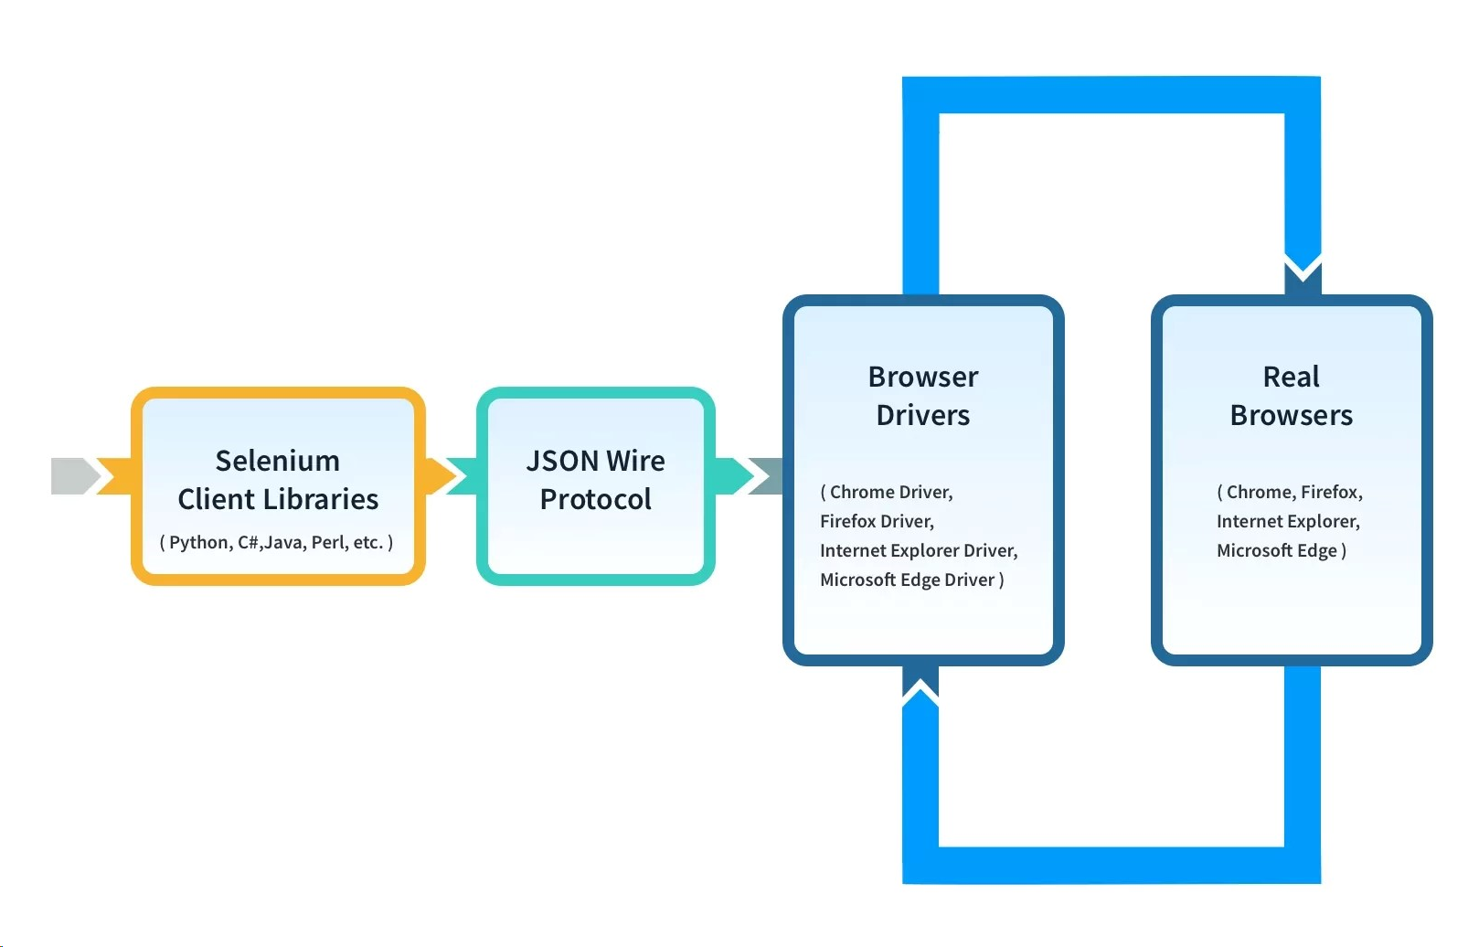
Selenium WebDriver Framework Architecture

Slide 10
What is XPath in Selenium
XPath is a Selenium technique that is used to navigate through the HTML structure of a webpage. It is a syntax or language that makes finding elements on a webpage possible using XML path expression.
XPath in Selenium has a basic format and that is explained below.

Slide 11
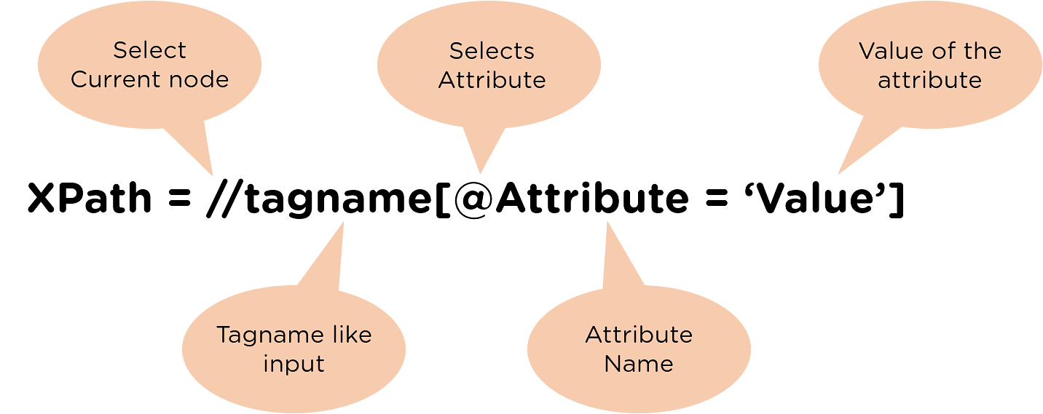
SYNTAX OF XPATH

Slide 12
WHAT IS TESTNG
TestNG is an automation testing framework in which NG stands for “Next Generation”. TestNG is inspired by JUnit which uses the annotations (@). TestNG overcomes the disadvantages of JUnit and is designed to make end-to-end testing easy.

Slide 13
WHY use TESTNG with Selenium?
Default Selenium tests do not generate a proper format for the test results. Using TestNG in Selenium, we can generate test results.
Generate the report in a proper format including a number of test cases runs, the number of test cases passed, the number of test cases failed, and the number of test cases skipped.
Multiple test cases can be grouped more easily by converting them into testng.xml file. In which you can make priorities which test case should be executed first.
The TestNG framework can be easily integrated with tools like TestNG Maven, Jenkins, etc.
Annotations used in the testing are very easy to understand ex: @BeforeMethod, @AfterMethod, @BeforeTest, @AfterTest

Slide 14

Cucumber Testing
“
Cucumber is a software tool used by the testers to develop test cases for the testing of behavior of the software."
Cucumber tool plays a vital role in the development of acceptance test cases for automation testing. It is mainly used to write acceptance tests for web applications as per the behavior of their functionalities.
It follows a BDD (Behavior Driven Development) framework to observe the behavior of the software's functionalities.
Adding request for tables
Getting list of requested tables

Slide 15
Basic Terms of Cucumber
Features
Tags
Gherkin Language
Step Definition
Feature File
Scenario

Slide 16
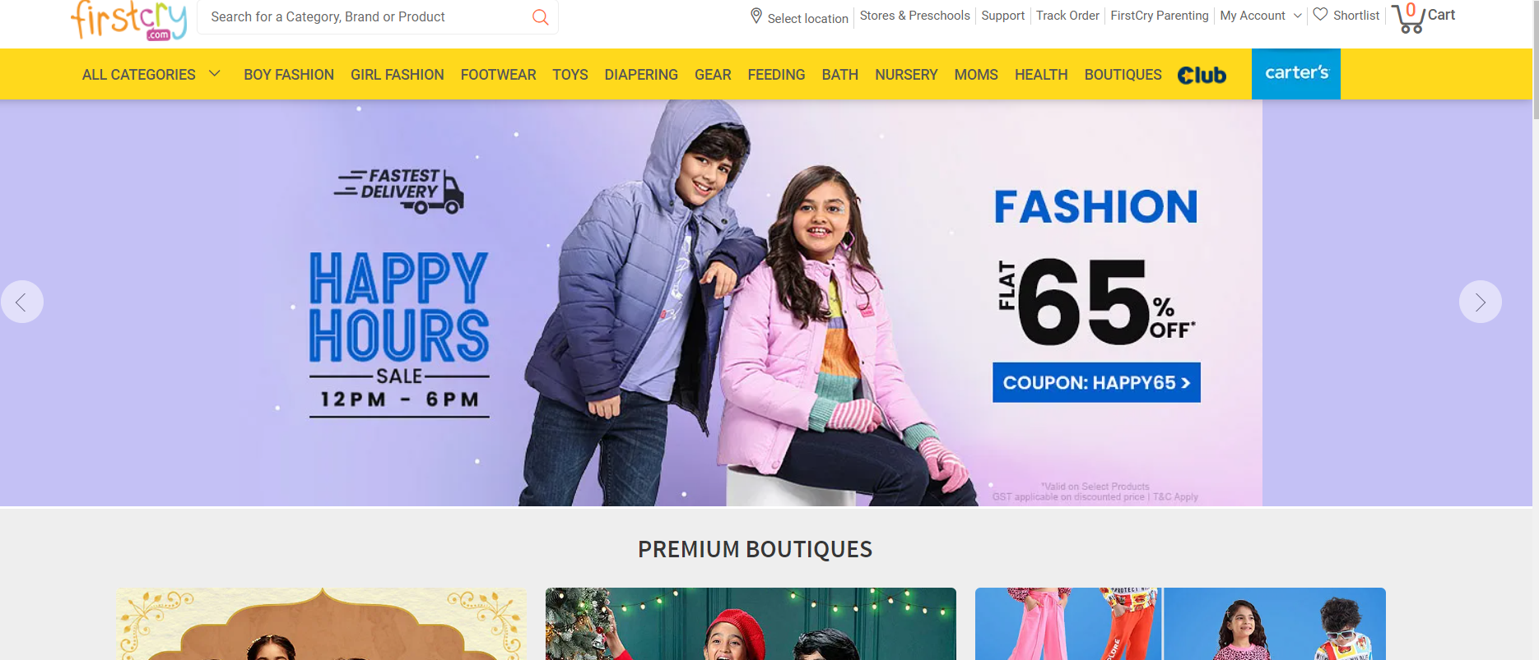
WELCOME PAGE

Slide 17
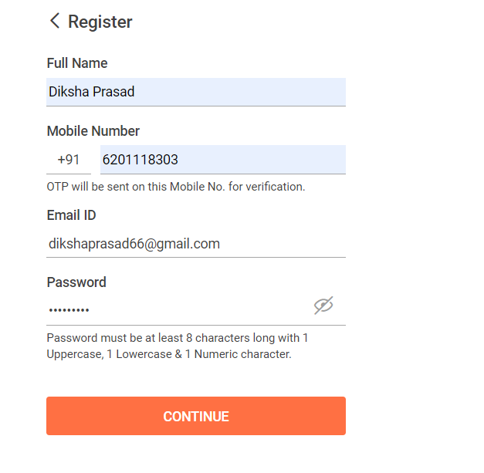
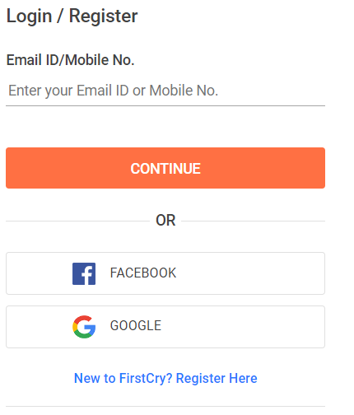
USER PROTAL User Login And Register New User

Slide 18
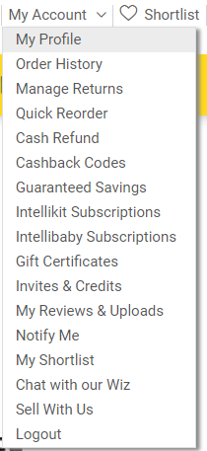
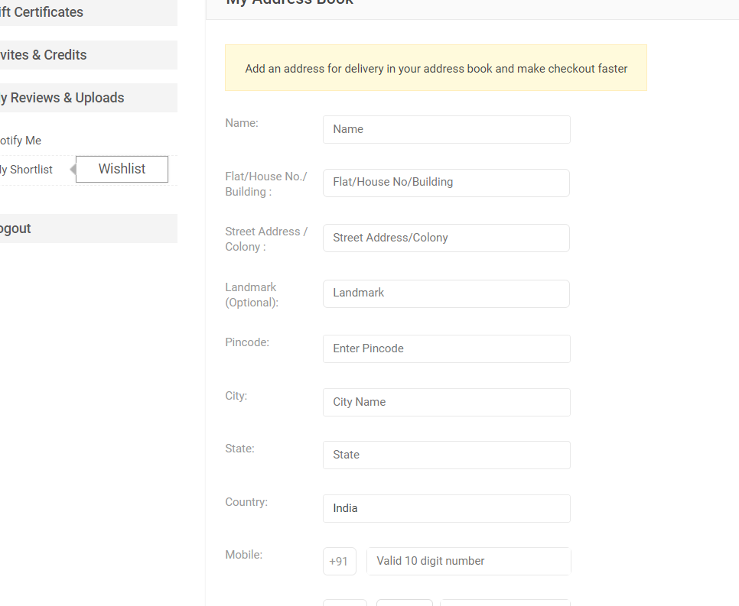
User Can go to my profile and edit

Slide 19

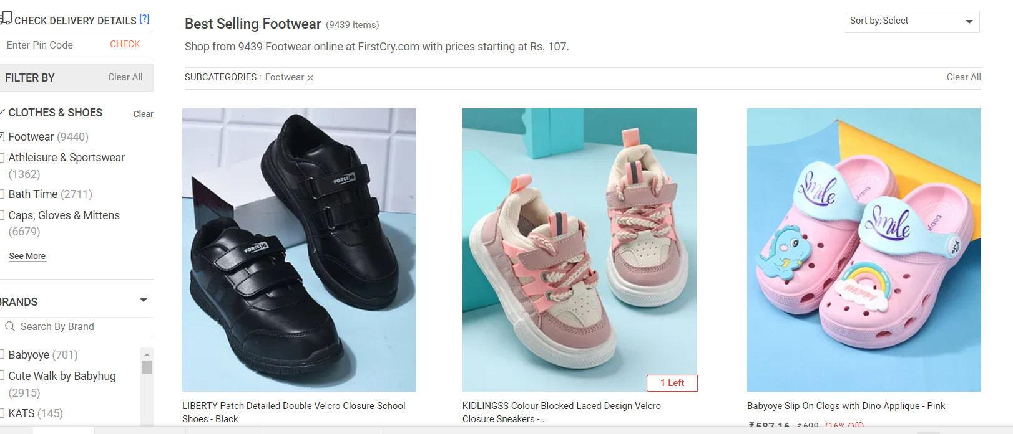

Slide 20
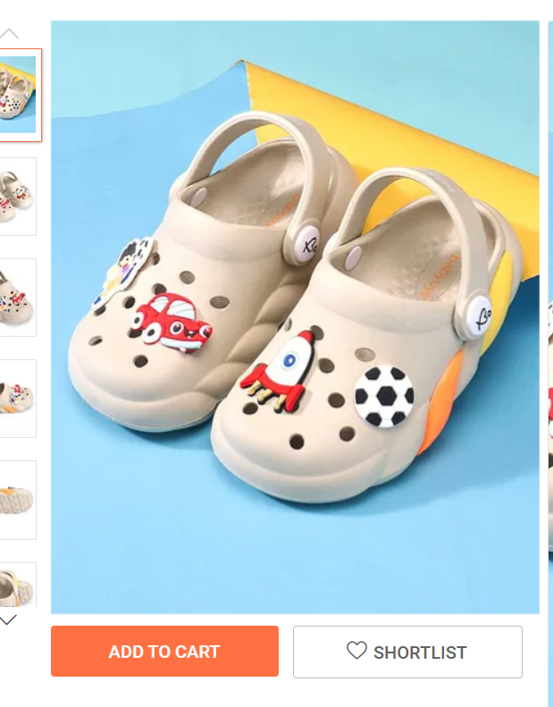
Add The Item to the cart

Slide 21
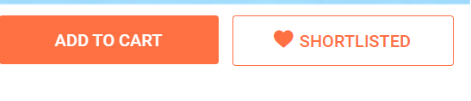
SHORLIST THE PRODUCT

Slide 22
THANK YOU

